Slide 1









ASTHMA PATIENT COUNSELLING
NAME : PUNITHA S
REG NO : I20401020
COURSE : PHARM.D IV YEAR
SUBJECT: 4.3 P CLINICAL PHARMACY

Slide 2
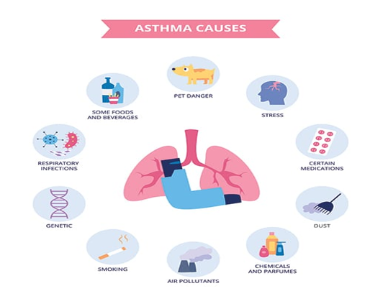
DEFINITION:
A Condition in which a person’s airways becomes inflamed, narrow and swell and produce extra mucus ,which makes it difficult to breathe.
ETIOLOGY:

Slide 3
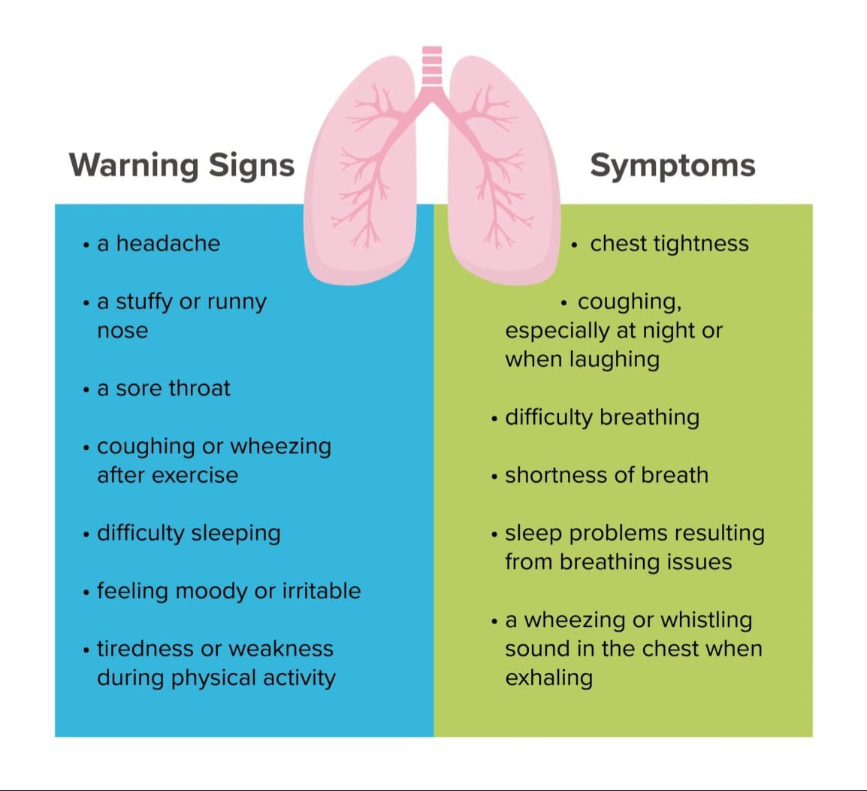
CLINICAL MANIFESTATION:

Slide 4
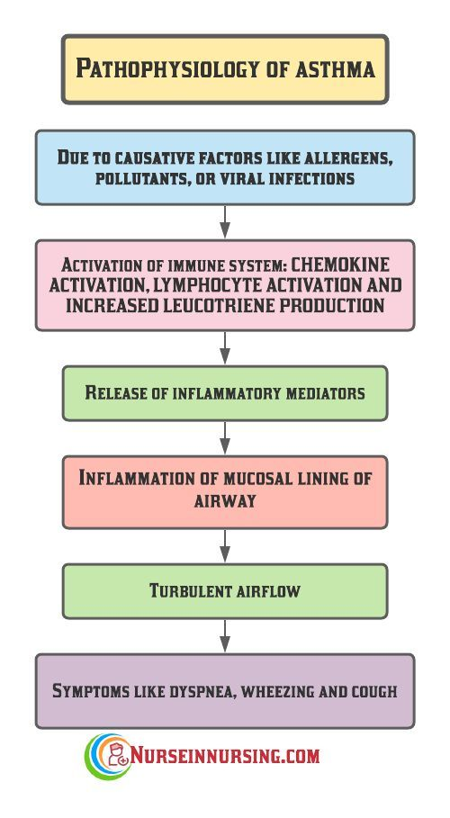
PATHOPHYSIOLOGY:

Slide 5
THERAPEUTIC MANAGEMENT:
NON PHARMACOLOGICAL:
Reduce exposure to indoor allergens
Avoid tobacco smoke
Avoid vehicle emission
Identify irritants in the workplace
Explore role of infections on asthma development ,especially in children and young infants

Slide 6
PHARMACOLOGICAL TREATMENT:
DUOLIN:[Duolin respules nebulizer]
Comes under the class of bronchodilators.
Convenient ,rapid, onset, without significant systemic side effect.
Use >2 times a week indicates need of regular controller therapy.
Side effects :
Dryness in mouth.
Cough headache
Palpitation
These side effects fade away with time.

Slide 7
BUDECORT:[Budesonide respules nebulizer]
Comes under the class of corticosteroids.
Budesonide is a medication used to manage and treat inflammatory diseases.
And also used to control the development of asthma.
Side effects :
High temperature
Ear or sinus pain
A change in colour of mucus
It should be administered with the help of nebulizer. Put the respule solution into nebulizer, let it transform into a fine mist and then inhale it through a face mask or mouthpiece.

Slide 8
ASTHALIN:
Asthalin syrup is a bronchodilator which contains salbutamol.
IT works by relaxing and widening the lung’s airways, making it easier to breathe, especially in asthma and COPD.
It also used for dry cough.
Side effects:
you may experience chest pain and breathing problem during the treatment.
You can take with or without food.
Try to take it at the same time each day.

Slide 9
HYDROCOTISONE:
Make sure you swallow all the of the liquid, otherwise you may not get all of the dose.
You should monitor blood pressure and blood sugar level that patient with DM may leads to increase in BSL
Side effect:
Headache, Muscleache, Diarrhoea
PARACETAMOL:
It is a non opiod analgesic and anti pyretic drug .
It is indicated for the relief of fever which is caused by Budecort drug.

Slide 10
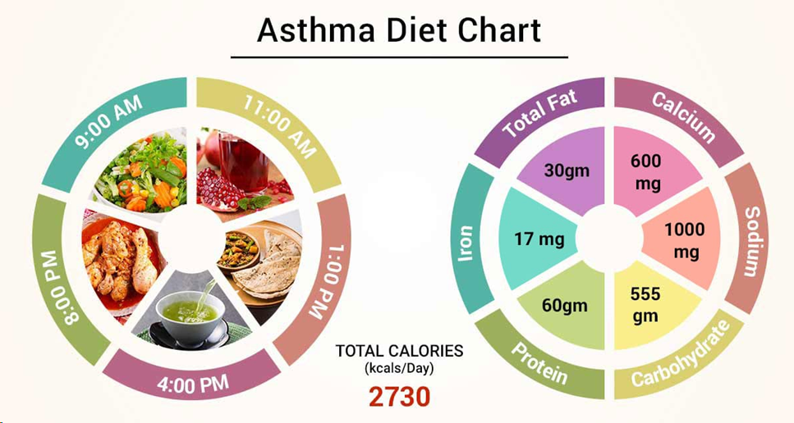
DIET PLANS:

Slide 11
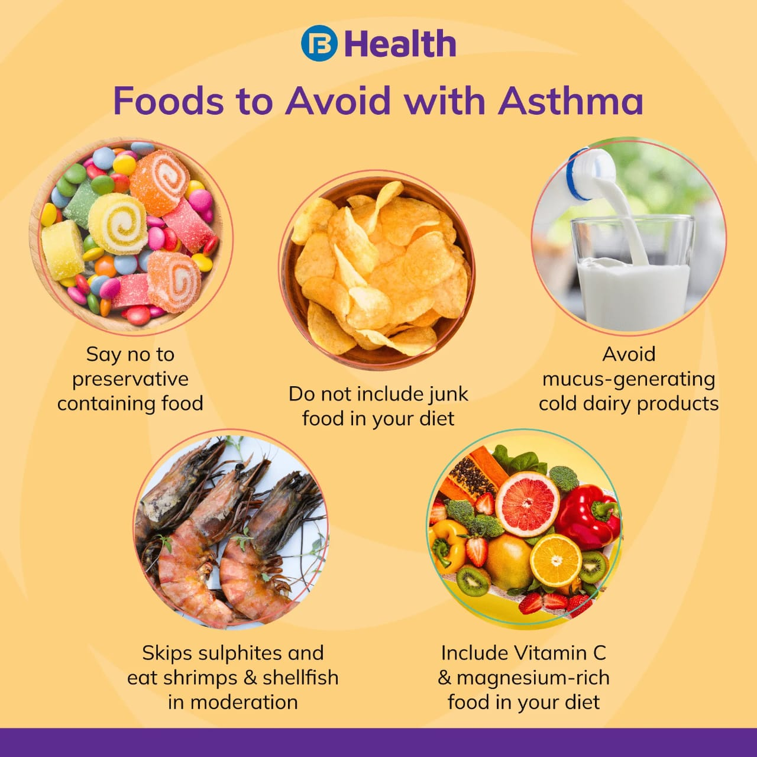

Slide 12
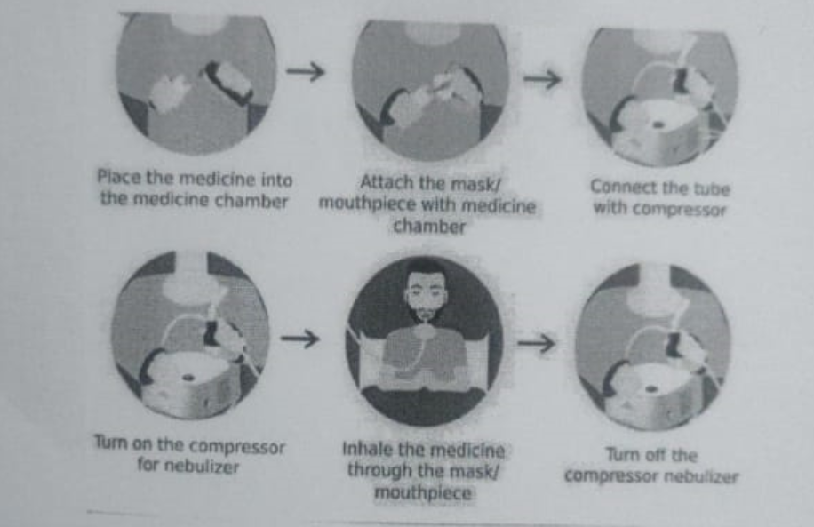
HOW TO USE INHALER

Slide 13
TIPS TO DO WHEN YOU DO NOT HAVE ON INHALER
• Sit up straight - sitting upright can help keep your airways open
• Remain calm - try to remain as calm as you can while you are having an asthma attack
• Steady your breathing - try to take slow, steady breaths during your attack
• Move away from triggers
• Get medical help

Slide 14
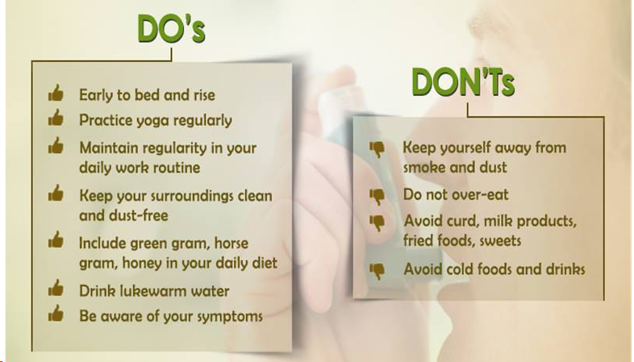
DO’S AND DON’TS:

Slide 15


